Slide 1
NETWORK TOPOLOGIES
DATA COMMUNICATIONS & NETWORKS (CSC 411)
The term topology in the context of communication network refers to the way the computers or workstations in the network are linked together. According to the physical arrangements of workstations and nature of work, there are three major types of network topology. They are star topology, bus topology and ring topology.
• Topology - Physical and logical network layout
– Physical – actual layout of the computer cables and other network devices
– Logical – the way in which the network appears to the devices that use it.
• Common topologies:
– Star, Bus, ring, mesh and wireless
Notes:
DATA STRUCTURES – CSC 221 LECTURE NOTES

Slide 2
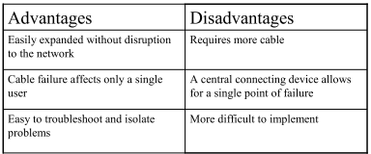
Star topology
In star topology a number of workstations (or nodes) are directly linked to a central node (see, Fig. 1). Any communication between stations on a star LAN must pass through the central node. There is bi-directional communication between various nodes. The central node controls all the activities of the nodes.
The advantages of the star topology are:
It offers flexibility of adding or deleting of workstations from the network.
Breakdown of one station does not affect any other device on the network.
The major disadvantage of star topology is that failure of the central node disables communication throughout the whole network

Slide 3
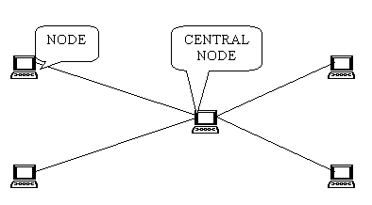
Fig. 1: Star Topology

Slide 4
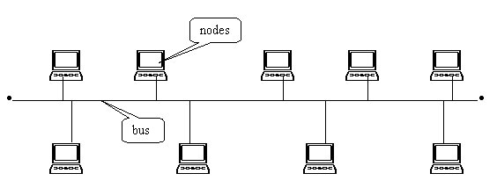
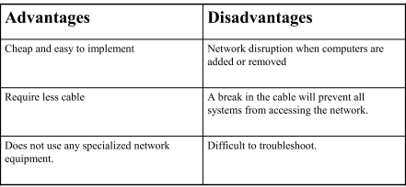
2. Bus Topology
In bus topology all workstations are connected to a single communication line called bus. In this type of network topology there is no central node as in star topology. Transmission from any station travels the length of the bus in both directions and can be received by all workstations. The advantage of the bus topology is that
i. It is quite easy to set up.
ii. If one station of the topology fails it does not affect the entire system.
The disadvantage of bus topology is that any break in the bus is difficult to identify.
Fig. 2: Bus Topology

Slide 5
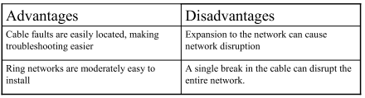
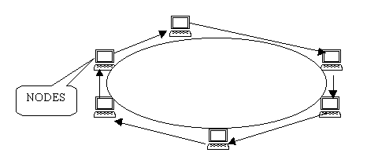
3. Ring Topology
In ring topology each station is attached nearby stations on a point to point basis so that the entire system is in the form of a ring. In this topology data is transmitted in one direction only. Thus the data packets circulate along the ring in either clockwise or anti-clockwise direction. The advantage of this topology is that any signal transmitted on the network passes through all the LAN stations. The disadvantage of ring network is that the breakdown of any one station on the ring can disable the entire system.
Fig. 3: Ring Topology

Slide 6
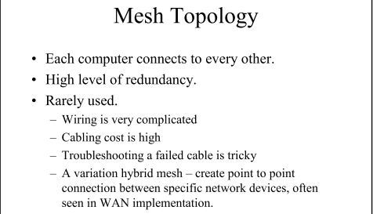

Slide 7
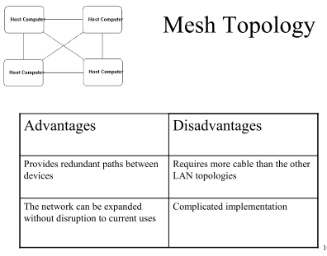

Slide 8
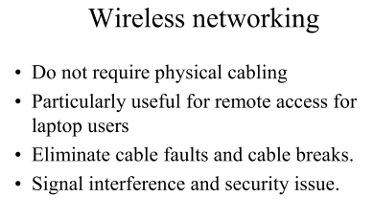

Slide 9
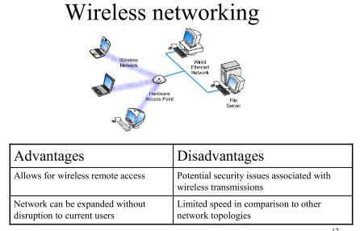

Slide 10
1.0 Data Transmission
1.1 Overview
Data Transmission is a process whereby data or information is transmitted in coded form from one computer (sender) to another computer (receiver) at a distance via communication facilities/devices. Good examples of communication devices are multiplex or, modem, telephone, routers, gateways etc.
1.2 Data communication devices
Some of the basic components of data transmission system or internetworking devices include: Repeaters, Hubs, Routers, Switches, Bridges, Wire cable, Microwaves, Optical fiber, Telephone, Multiplex or, Radio, Gateway, Modern.
We started by defining each device followed by the various types and lastly how they work.
1. Repeaters: A device set at intervals along a circuit to regenerate or boost the signal preventing its decay over distance. Repeaters regenerate digits signals without change; they simply boost analog signals.
A repeater extends the length of a network cabling system by amplifying the signal and then re-transmitting it. Repeaters operate at Physical Layer 1. As a result, they do not look at the data at all. Any information coming into one port is simply repeated out all other ports.
Notes:
DATA TRANSMISSION LECTURE NOTES

Slide 11
Data communication devices cont….
2. Hubs: Hub is simply seen as a common connection point for devices in a network. Hubs are commonly used to connect segments of LAN together. A hub contains multiple ports, when a packet arrives at one port; it is copied to the other ports so that all segments of the LAN can see all packets.
3. Router: While bridges can link similar LANs that do not necessarily have the same protocols, a router can only send data through compatible protocol path.
The function of a router is to direct data along the most efficient and economical route to the destination device.
4. Switches: Switches are becoming a more common way to connect networks together because they are simply faster and more intelligent than bridges. Advances in technology spawned a new generation of networking devices known as LAN switches, which included bridging as one of several functions. Switches have replaced bridges for two reasons: superior performance and lower price per port.
5. Bridges: Bridges can be defined as a device that is used to connect two local area network or two segments of the same LAN that uses the same protocol together such protocol include Ethernet or token ring.

Slide 12
Data communication devices cont….
6. Multiplexor: Multiplexor is a communication device that receives data from a number of channels and retransmit through a single line at low speed. Multiplex or perform its function by reducing the total communication costs and also has the ability of transmitting batch messages at high speed to computer system.
7. Gateway: Unlike a bridge which connects between similar Networks, a gateway is a computer that connects incompatible networks e.g. PCVLAN to a mainframe LAN.
8. Modem: Acronym for Modulator –Demodulator is a device that convert electrical signals from a computer into an audio form transmittable over telephone lines, or vice versa.
Modem otherwise known as a data set can also be defined as a device or program that enables a computer to transmit data over telephone or cable lines. The modems are used to handle the data stream from a peripheral device to the central processor and vice-versa through the common carrier network.

Slide 13
2.0 COMMUNICATION CHANNEL
Communication channels are divided in two categories, namely guided media and unguided media.
2.1 Guided Media
In this category the communication device is attached to each other directly with cables. The data signals are restricted to a cabling platform and thus they are also known as bounded media. Generally the guided media is called LAN. Some kinds of guided media are coaxial cable, twisted pair wire and fiber optic cable
1. Twisted Pair Cable - It is the most common used communication media and used in LAN (local area network) for transfer of data between various computers. A twisted pair cable is made of two plastic insulated copper wires twisted together to form a single media as shown in figure 1. Out of these two wires, only one carries actual signal and another is used for ground reference. The twists between wires are helpful in reducing noise electro − magnetic interference and crosstalk. They are also used in landline telephones to transfer data signals and voice. They are made from a pair of copper wire. They are covered with insulating materials like plastic. The transmission of data takes place at a speed of 9600 bits/second within a distance of 100 meters.

Slide 14
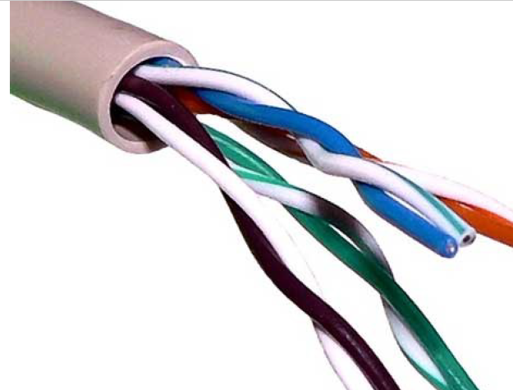
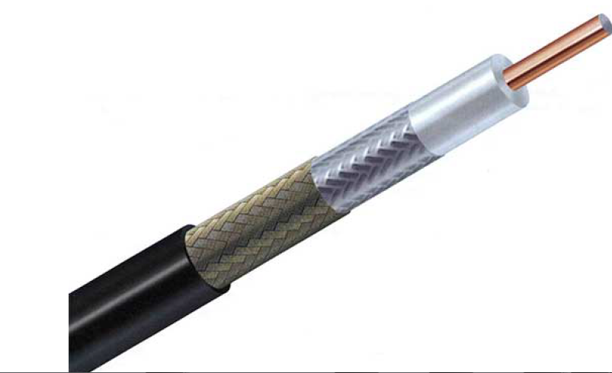
2. Coaxial cable: Coaxial cable also known as coaxes has two wires of copper. The core wire lies in the center and it is made of solid conductor. The core is enclosed in an insulating sheath as shown in figure 2. The second wire is wrapped around over the sheath and that too in turn encased by insulator sheath. This all is covered by plastic cover. Because of its structure the coax cable is capable of carrying high frequency signals than that of twisted pair cable. The wrapped structure provides it a good shield against noise and cross talk. Coaxial cables provide high bandwidth rates of up to 450 mbps.
There are three categories of coax cables namely, RG-59 Cable TV , RG-58 Thin Ethernet , and RG-11 Thick Ethernet where RG stands for Radio Government.
Fig. 1: Twisted Pair Cable
Fig. 2: Coaxial cable

Slide 15
Advantages coaxial cable
i. Inexpensive
ii. Easy to wire
iii. Easy to expand
iv. Moderate level of EMI immunity
Disadvantage coaxial cable
Single cable failure can take down an entire network
3. Fiber Optic Cable - They use light to transfer data. The data is transferred at a very high speed of billions bit/second. They are highly used by cable operators, telephone, and broadband internet companies. They are made from glass and is as thin as the human hair. They are coated with plastic also known as jacket.
4. Fiber Optics
Fiber Optic works on the properties of light. When light ray hits at critical angle it tends to refracts at 90 degree. This property has been used in fiber optic. The core of fiber optic cable is made of high quality glass or plastic. From one end of it light is emitted, it travels through it and at the other end light detector detects light stream and converts it to electric data.

Slide 16
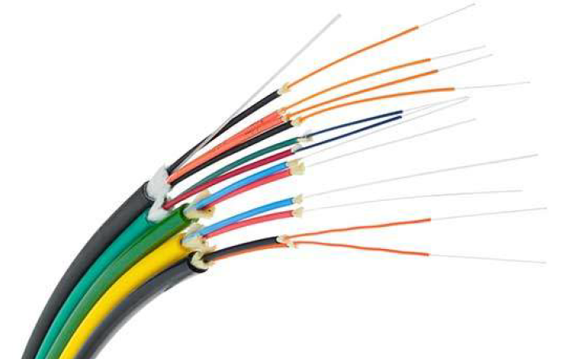
4. Fiber Optics cont…
Fiber Optic provides the highest mode of speed. It comes in two modes, one is single mode fiber and second is multimode fiber. Single mode fiber can carry a single ray of light whereas multimode is capable of carrying multiple beams of light as shown in figure 3.
Advantages of Fiber Optic Cable:
i. Fast
ii. Low attenuation
iii. No EMI interference
Disadvantages Fiber Optics:
i. Very costly
ii. Hard to install
Fig. 3: Fiber Optic

Slide 17
5. Power Lines
Power Line communication PLC is Layer-1 Physical Layer technology which uses power cables to transmit data signals. In PLC, modulated data is sent over the cables. The receiver on the other end demodulates and interprets the data.
Because power lines are widely deployed, PLC can make all powered devices controlled and monitored. PLC works in half-duplex.
There are two types of PLC:
• Narrow band PLC
• Broad band PLC
Narrow band PLC provides lower data rates up to 100s of kbps, as they work at lower frequencies 3-5000 KHz
.They can be spread over several kilometers.
Broadband PLC provides higher data rates up to 100s of Mbps and works at higher frequencies 1.8-250 MHz
.They cannot be as much extended as Narrowband PLC

Slide 18
2.2 Unguided Media
In this form the data is transferred in the form of waves. This means that they do not travel along a specific path. It is also known as unbounded media. Data can be transferred all over the globe. Kinds of unguided media are microwave, cellular radio, radio broadcast and satellite.
1. Microwaves-Microwaves is a communication channel by which data are transmitted in empty space. Its straight line transmission is similar in operation to radio, and television mode of transmitting signal. For a radio and television signals to travel through a long distance in empty space, there is a need for microwave to boost or redirect the signal as it always travel on a straight line without bending.
In this kind the data is transferred via air. The speed at which data is transferred is 150 Mbps.
Advantages of Microwaves
i. It is suitable for long distance transmission as it does not require physical link
ii. It is more reliable as compared to wire cable
Disadvantages of microwaves:
i. It is very costly to set up
ii. It requires highly skilled personnel for operation and maintenance

Slide 19
2. Satellite- The signals are received from earth stations. Devices like GPS and PDAs also receive signals from these earth based stations. These satellites are located at a distance of 22300 miles above the earth. The process of transferring and receiving data takes place within few seconds. The data is transferred at a speed of 1 Gbps. One of the advantages is the speed. Satellite Internet is 50 times faster than dial up and about 25 times faster than high-speed cable.
The cost of satellite Internet is also a huge advantage in that for everything the consumer gets, the price is low.
They are used for purposes like weather forecast, military communication, radio transmission, satellite TV, data transmission, etc.
3. Cellular Radio: are used for communication via mobile. High frequency radio waves are used for the transmission of data. You can receive and make calls and also access the internet. 4. Radio Broadcasting: Data is transferred and received via radio signals in the air. The transmission takes place for a long distance across cities or countries. The data is received and transferred via a transmitter. The speed at which data travels is 54 Mbps.

Slide 20
1.0 ETHERNET CABLE BASICS
1.1 Overview
The Ethernet cables for connectivity in most office and home environments rely on twisted wire pairs within an overall cable - Cat 5, Cat 6 and Cat 7 all used this format. Twisting the wires together enables the currents to balance, i.e. in one wire the current is moving in one direction, and in the other wire of the pair the current is going in the other, enabling the overall fields around the twisted pair to cancel.
In this way, data can be transmitted over considerable lengths without the need for undue precautions.
As several twisted pairs are contained within a particular network cable, the number of twisted per unit length is arranged to be different for each pair - the rate being based on prime numbers so that no two twists ever align. This reduces crosstalk within the cable.
The Ethernet cables are available in a variety of lengths as patch cables, or the cable itself is available for incorporating into systems, buildings, etc. The terminations can then be made to the required connector using a crimp tool. These network cables are available in a variety of lengths - long Ethernet cables are available, some of the longest being up to 75 metres.
Notes:
DATA TRANSMISSION LECTURE NOTES

Slide 21
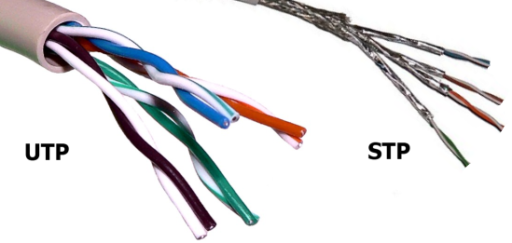
Shielded (STP) vs. Unshielded (UTP)
Because all Ethernet cables are twisted, manufactures use shielding to further protect the cable from interference. Unshielded twisted pair can easily be used for cables between your computer and the wall, but you will want to use shielded cable for areas with high interference and running cables outdoors or inside walls.
Earlier network cables were unshielded, but later ones were shielded to improve the performance. For example an unshielded twisted pair (UTP) cable may be satisfactory for a short run between a computer and router, but a foil shielded cable, FTP, is best longer runs or where the cable passes through areas of high electrical noise.
Fig. 1: UTP Vs STP Cable

Slide 22
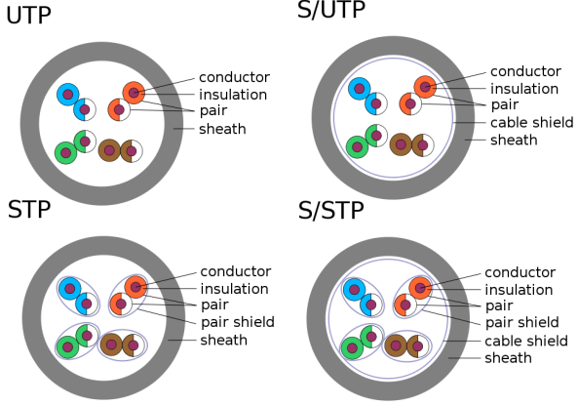
There are different ways to shield an Ethernet cable, but typically it involves putting a shield around each pair of wire in the cable. This protects the pairs from crosstalk internally. Manufactures can further protect cables from alien crosstalk but screening UTP or STP cables. Technically the picture above shows a Screened STP cable (S/STP).
Fig. 2: UTP Vs STP Cable

Slide 23
2.0 ETHERNET SHIELDING CODES
There are different methods that can be used for shielding Ethernet cables. The most common is to place a shield around each twisted pair. This not only provides shielding for the cable externally, but also reduces crosstalk between the internal twisted pairs as well. Manufacturers can further enhance the performance by placing shielding around all the wires in the cable just under the cable sheath. There are different codes used to indicate the differs types of shielding:
U/UTP - Unshielded cable, unshielded twisted pairs
F/UTP - Foil shielded cable, unshielded twisted pairs
U/FTP - Unshielded cable, foil shielded twisted pairs
S/FTP - braided shielded cable, foil shielded twisted pairs
Where:
TP = twisted pair, U = unshielded, F = foil shielded, S = braided shielding
A further difference within the Ethernet cables whether Cat 5, Cat 5e, Cat 6, Cat 6e, or Cat 7 can be whether solid or stranded wires are used within the cable. As the description implies, a solid cable uses a single piece of copper for the electrical conductor within each wire of the cable whilst stranded wire uses a series of copper strands twisted together. Although when buying a patch cable, it may not be necessary to know this, when installing a long cable run it may be important as each type is slightly more suitable for different applications.

Slide 24
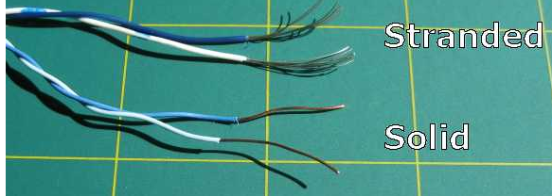
Stranded cable: This type of wire is more flexible and it is more applicable for Ethernet cables where the cable may be moved - often it is idea for patch leads at desks or general connections to PCs, etc where some movement may be needed and expected.
Solid cable: Solid cable is not as flexible as the stranded type, but it is also more durable. This makes it best for use in permanent installations like cable installations under floors, embedded in walls and the like.
Fig. 3: Stranded vs Solid Twisted Pair Cable

Slide 25
Categories of Ethernet cables
A variety of different cables are available for Ethernet and other telecommunications and networking applications. These network cables that are described by their different categories, e.g. Cat 5 cables, Cat-6 cables, etc, which are often recognised by the TIA (telecommunications Industries Association) and they are summarised below:
Cat-1: This is not recognised by the TIA/EIA. It is the form of wiring that is used for standard telephone (POTS) wiring, or for ISDN.
Cat-2: This is not recognised by the TIA/EIA. It was the form of wiring that was used for 4Mbit/s token ring networks.
Cat-3: This cable is defined in TIA/EIA-568-B. It is used for data networks employing frequencies up to 16 MHz. It was popular for use with 10 Mbps Ethernet networks (100Base-T), but has now been superseded by Cat-5 cable.
Cat-4: This cable is not recognised by the TIA/EIA. However it can be used for networks carrying frequencies up to 20 MHz. It was often used on 16Mbps token ring networks.

Slide 26
Categories for Ethernet cables cont…
Cat-5: This is not recognised by the TIA/EIA. This is the network cable that is widely used for 100Base-T and 1000Base-T networks as it provides performance to allow data at 100 Mbps and slightly more (125 MHz for 1000Base-T) Ethernet. The Cat 5 cable superseded the Cat 3 version and for a number of years it became the standard for Ethernet cabling. Cat 5 cable is now obsolete and therefore it is not recommended for new installations.
Cat 5 cable uses twisted pairs to prevent internal crosstalk, XT and also crosstalk to external wires, AXT. Although not standardised, the Cat 5 cable normally uses 1.5 - 2 twists per centimetre.
Cat-5e: This form of cable is recognised by the TIA/EIA and is defined in TIA/EIA-568, being last revised in 2001. It has a slightly higher frequency specification that Cat-5 cable as the performance extends up to 125 Mbps.

Slide 27
Categories for Ethernet cables cont…
Cat-5e can be used for 100Base-T and 1000Base-t (Gigabit Ethernet). Cat 5e standard for Cat 5 enhanced and it is a form of Cat 5 cable manufactured to higher specifications although physically the same as Cat 5. It is tested to a higher specification to ensure it can perform at the higher data speeds. The twisted pairs within the network cables tend to have the same level of twisting as the Cat 5 cables.
Cat-6: This cable is defined in TIA/EIA-568-B provides a significant improvement in performance over Cat5 and Cat 5e. During manufacture Cat 6 cables are more tightly wound than either Cat 5 or Cat 5e and they often have an outer foil or braided shielding. The shielding protects the twisted pairs of wires inside the Ethernet cable, helping to prevent crosstalk and noise interference. Cat-6 cables can technically support speeds up to 10 Gbps, but can only do so for up to 55 metres - even so this makes them relatively long Ethernet cables. The Cat 6 Ethernet cables generally have 2+ twists per cm and some may include a nylon spline to reduce crosstalk, although this is not actually required by the standard.

Slide 28
Cat-6a: The “a” in Cat 6a stands for “Augmented” and the standard was revised in 2008. The Cat 6a cables are able to support twice the maximum bandwidth, and are capable of maintaining higher transmission speeds over longer network cable lengths. Cat 6a cables utilise shielded which is sufficient to all but eliminate crosstalk. However this makes them less flexible than Cat 6 cable.
Cat-7: This is an informal number for ISO/IEC 11801 Class F cabling. It comprises four individually shielded pairs inside an overall shield. It is aimed at applications where transmission of frequencies up to 600 Mbps is required.
Cat-8: These cables are still in development, but will be released in the foreseeable future to provide further improvements in speed and general performance.

Slide 29
1 How to Calculate Data Transfer Rate
Data transfer rate is the speed that a certain amount of data is transferred over a given period of time. You might want to know the transfer rate if you’re downloading something online or transferring data from one source to another. First, convert your units so the file size and transfer speed are in either bits or bytes with the same prefix (kilo, mega, giga, or tera). Then, plug your numbers into the equation S = A ÷ T in which A is the amount of data and T is the transfer time to solve for S, the speed, or rate, of transfer. You can also determine the amount of data or the transfer time if you know one of the variables plus the speed of transfer.
Coverting Units
b bit
B byte
kB kilobyte
MB megabyte
GB gigabyte
TB terabyte
Notes:
DATA TRANSFER RATE LECTURE NOTES

Slide 30
2
Find the units regarding the file size. File sizes may be given in bits (b), bytes (B), Kilobytes (KB), Megabytes (MB), Gigabytes (GB), or even Terabytes (TB).
Pay attention to whether the letters are upper case or lower case as well. For instance, a bit is denoted with a lowercase “b” while a byte is denoted with an uppercase “B”.
3
Note the units that reference the transfer speed. Transfer speeds might be provided in bits per second (bps), bytes per second (B/s), Kilobytes per second (KB/s), Megabytes per second (MB/s), or Gigabytes per second (GB/s).
8bits = 1B
2¹⁰ or 1024 B = 1kB
2¹⁰ or 1024 kB = 1MB
2¹⁰ or 1024 MB = 1GB
2¹⁰ or 1024 GB = 1TB
b/s
B/s
kB/s
MB/s
GB/s
TB/s

Slide 31
4
Convert the units to either bits or bytes and make sure they have the same prefix.
Before you use the transfer rate equation, ensure you are using the same units for the size and speed. Don’t worry about the time units for now.
8 bits (b) = 1 byte (B); turn bits into bytes by dividing by 8, or convert bytes to bits by multiplying by 8.
1,024 bytes = 1 Kilobyte (KB); convert bytes to Kilobytes by dividing by 1,024 or turn Kilobytes into bytes by multiplying by 1,024.
1,024 Kilobytes = 1 Megabyte (MB); change Kilobytes into Megabytes by dividing by 1024 or convert Megabytes into Kilobytes by multiplying by 1,024.
1,024 Megabytes = 1 Gigabyte (GB); convert Megabytes into Gigabytes by dividing by 1024 or turn Gigabytes into Megabytes by multiplying by 1,024.
1,024 Gigabytes = 1 Terabyte (TB); change Gigabytes into Terabytes by dividing by 1024 or convert Terabytes into Gigabytes by multiplying by 1,024.
60s = 1 min
60min = 1 hr

Slide 32
5
Convert between hours, minutes, and seconds as needed. As you know, there are 60 seconds in 1 minute and 60 minutes in 1 hour. To convert from seconds to minutes, divide by 60. To convert from minutes to hours, divide by 60. To convert from hours to minutes, multiply by 60. To convert from minutes to seconds, multiply by 60.
To convert from seconds to hours, divide by 3,600 (60 x 60). Or, convert from hours to seconds by multiplying by 3,600.
Generally, the speed is denoted in seconds. If you have very many seconds, though, such as for large files, you can convert to minutes or even hours
Calculating Transfer Speed, Time, and Data
Example 1: Given T = 2min = 120s
A = 25MB
S = A / T = 25MB/120s =0.208MB/s

Slide 33
6
Calculate the transfer speed by dividing the amount of data by the transfer time. Plug the amount of data (A) and transfer time (T) to solve for the rate, or speed (S), into the equation S = A ÷ T.
For example, you might have transferred 25 MB in 2 minutes. First, convert 2 minutes to seconds by multiplying 2 by 60, which is 120. So, S = 25 MB ÷ 120 seconds. 25 ÷ 120 = 0.208. Therefore, the transfer speed is 0.208 MB/s. If you want to turn this into Kilobytes, multiply 0.208 by 1024. 0.208 x 1024 = 212.9. So, the transfer speed is also equal to 212.9 KB/s.
Example 2: Given S = 7MB/s
A = 134GB = 137,217MB
T = A/ S =137,217MB / 7MB/s =19,602s

Slide 34
7
Divide the amount of data by the transfer speed to find the transfer time.
If you want to solve for the transfer time (T) instead, input the amount of data (A) and the rate or speed (S) of transfer into the equation T = A ÷ S.
For instance, say you transferred 134 GB at a rate of 7 MB/s. First, convert GB to MB so you’re working with the same units in each part of the equation. 134 x 1,024 = 137,217. So, you transferred 137,217 MB at a rate of 7 MB/s. To solve for T, divide 137,217 by 7, which is 19,602. Therefore, it took 19,602 seconds. To convert this to hours, divide by 3,600, which is 5.445. In other words, it took 5.445 hours to transfer 134 GB at a rate of 7 MB/s.
If you want to use hours and minutes, separate out the whole number and decimal: you have 5 hours and 0.445 hours. To convert 0.445 hours to minutes, multiply by 60. 0.445 x 60 = 26.7. To convert the decimal into seconds, multiply it by 60. 0.7 x 60 = 42. Altogether, it took 5 hours, 26 minutes, and 42 seconds.
Example 3: T = 1.5hr = 5,400s
S = 200bps
A = T *S = 5,400s * 200bps
A = 1,080,000

Slide 35
8
Multiply the transfer time by the transfer speed to find the amount of data transferred.
To figure out how much data was transferred, use the equation A = T x S, in which A is the amount of data, T is the transfer time, and S is the speed or rate of transfer.
For example, you can figure out how much data was transferred in 1.5 hours at a rate of 200 bps. First, convert hours to seconds by multiplying by 1.5 by 3,600, which is 5,400. So, A = 5,400 seconds x 200 bps. A = 1,080,000 bps. To convert to bytes, divide by 8. 1,080,000 ÷ 8 = 135,000. To convert to Kilobytes, divide by 1,024. 135,000 ÷ 1,024 = 131.84. Therefore, 131.84 KB of data was transferred in 1.5 hours at a rate of 200 bps.

Slide 36
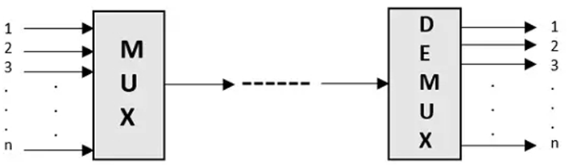
Concepts of Multiplexing
Multiplexing is the process of combining multiple signals into one signal, over a shared medium. If the analog signals are multiplexed, then it is called as analog multiplexing. Similarly, if the digital signals are multiplexed, then it is called as digital multiplexing.
Multiplexing was first developed in telephony. A number of signals were combined to send through a single cable. The process of multiplexing divides a communication channel into several number of logical channels, allotting each one for a different message signal or a data stream to be transferred. The device that does multiplexing can be called as Multiplexer or MUX.
The reverse process, i.e., extracting the number of channels from one, which is done at the receiver is called as de-multiplexing. The device that does de-multiplexing can be called as de-multiplexer or DEMUX.
The following figures illustrates the concept of MUX and DEMUX. Their primary use is in the field of communications.
Fig. 1: Multiplexing and Demultiplexing
Notes:
TELECOMMUNICATION NETWORKS

Slide 37
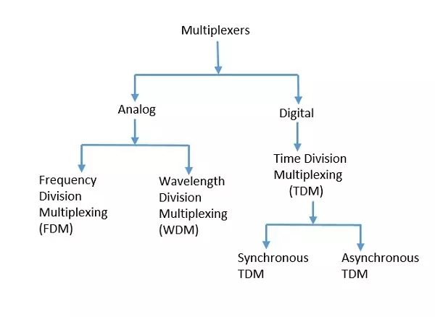
The process of multiplexing divides a communication channel into several number of logical channels, allotting each one for a different message signal or a data stream to be transferred. The device that does multiplexing can be simply called as a MUX while the one that reverses the process which is demultiplexing, is called as DEMUX.
Types of Multiplexers
There are mainly two types of multiplexers, namely analog and digital. They are further divided into FDM, WDM, and TDM.
Analog Multiplexing
The analog multiplexing techniques involve signals which are analog in nature. The analog signals are multiplexed according to their frequency (FDM) or wavelength (WDM).
Notes:
TELECOMMUNICATION NETWORKS

Slide 38
Analog Multiplexing
Frequency Division Multiplexing (FDM)
In analog multiplexing, the most used technique is Frequency Division Multiplexing FDM. This technique uses various frequencies to combine streams of data, for sending them on a communication medium, as a single signal.
Example: A traditional television transmitter, which sends a number of channels through a single cable, uses FDM.
Wavelength Division Multiplexing (WDM)
Wavelength Division Multiplexing is an analog technique, in which many data streams of different wavelengths are transmitted in the light spectrum. If the wavelength increases, the frequency of the signal decreases.
Example: Optical fibre Communications use the WDM technique, to merge different wavelengths into a single light for the communication.
Digital Multiplexing
The term digital represents the discrete bits of information. Hence the available data is in the form of frames or packets, which are discrete.
Notes:
NETWORK ACCESS

Slide 39
Digital Multiplexing
Time Division Multiplexing (TDM)
In TDM, the time frame is divided into slots. This technique is used to transmit a signal over a single communication channel, with allotting one slot for each message. Of all the types of TDM, the main ones are Synchronous and Asynchronous TDM.
Synchronous TDM
In Synchronous TDM, the input is connected to a frame. If there are ‘n’ number of connections, then the frame is divided into ‘n’ time slots. One slot is allocated for each input line. In this technique, the sampling rate is common to all signals and hence same clock input is given. The mux allocates the same slot to each device at all times.
Asynchronous TDM
In Asynchronous TDM, the sampling rate is different for each of the signals and the clock signal is also not in common. If the allotted device, for a time-slot, transmits nothing and sits idle, then that slot is allotted to another device, unlike synchronous.
Notes:
NETWORK ACCESS

Slide 40
De-Multiplexer
De-multiplexers are used to connect a single source to multiple destinations. This process is the reverse process of multiplexing. As mentioned previously, it is used mostly at the receivers. DEMUX has many applications. It is used in receivers in the communication systems. It is used in arithmetic and logical unit in computers to supply power and to pass on communication, etc.
De-multiplexers are used as serial to parallel converters. The serial data is given as input to DEMUX at regular interval and a counter is attached to it to control the output of the de-multiplexer.
Both the multiplexers and de-multiplexers play an important role in communication systems, both at the transmitter and the receiver sections.
Statistical Multiplexing
Statistical Multiplexing is a multiplexing technique that allows information from a number of channels to be combined for transmission over communication networks
Statistical multiplexing is sometimes referred to as statistical time-division multiplexing (STDM) or statistical packet multiplexing (SPM), but the shorter term is used more often.
Notes:
NETWORK ACCESS

Slide 41
Statistical Multiplexing cont…
How Statistical Multiplexing Works?
Statistical multiplexing dynamically allocates bandwidth to each channel on an as-needed basis. This is in contrast to time-division multiplexing (TDM) techniques, in which quiet devices use up a portion of the multiplexed data stream, filling it with empty packets. Statistical multiplexing allocates bandwidth only to channels that are currently transmitting. It packages the data from the active channels into packets and dynamically feeds them into the output channel, usually on a FIFO (first in, first out) basis, but it’s also able to allocate extra bandwidth to specific input channels.
Statistical multiplexing devices usually support other features, such as the following:
Store-and-forward error detection and correction capability
Identifies which channel sent each packet of data and corrects errors that occur
Data compression:
Increases the amount of data that can be sent per packet
Notes:
NETWORK ACCESS

Slide 42
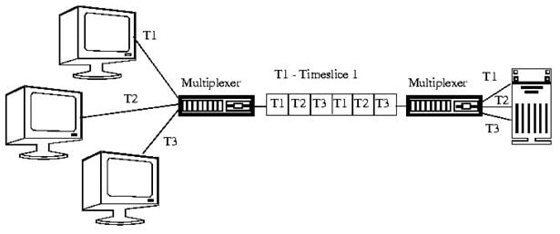
Statistical Multiplexing cont…
A multiplexer that is capable of statistically multiplexing several data streams together is sometimes called a statmux. If you have a statmux at each end of a digital line, the receiving statmux can identify the channel of each packet sent by the sending statmux and demultiplex the data stream into its original data channels.
Fig. 2: Statistical Multiplexing
Notes:
NETWORK ACCESS

Slide 43
Virtual Circuits and Datagram Networks
Computer networks that provide connection-oriented service are called Virtual Circuits while those providing connection-less services are called as Datagram networks. For prior knowledge, the Internet which we use is actually based on Datagram network (connection-less) at the network level as all packets from a source to a destination do not follow the same path.
Virtual Circuits
It is connection-oriented, meaning that there is a reservation of resources like buffers, CPU, bandwidth, etc. for the time in which the newly setup virtual circuit is going to be used by a data transfer session.
The first sent packet reserves resources at each server along the path. Subsequent packets will follow the same path as the first sent packet for the connection time.
Since all the packets are going to follow the same path, a global header is required. Only the first packet of the connection requires a global header, the remaining packets generally don’t require global headers.
Since all packets follow a specific path, packets are received in-order at the destination.
Virtual Circuit Switching ensures that all packets successfully reach the Destination. No packet will be discarded due to unavailability of resources.
From the above points, it can be concluded that Virtual Circuits are a highly reliable method of data transfer.

Slide 44
Virtual Circuits cont…
The issue with virtual circuits is that each time a new connection is set up, resources and extra information have to be reserved at every router along the path, which becomes problematic if many clients are trying to reserve a routers resources simultaneously.
It is used by the ATM (Asynchronous Transfer Mode) Network, specifically for Telephone calls.
Datagram Networks
It is a connection-less service. There is no need for reservation of resources as there is no dedicated path for a connection session.
All packets are free to use any available path. As a result intermediate routers calculate routes on the go due to dynamically changing routing tables on routers.
Since every packet is free to choose any path, all packets must be associated with a header with proper information about the source and the upper layer data.
The connection-less property makes data packets reach the destination in any order, which means that they can potentially be received out of order at the receivers end.
Datagram networks are not as reliable as Virtual Circuits.
The major drawback of Datagram Packet switching is that a packet can only be forwarded if resources such as the buffer, CPU and bandwidth are available. Otherwise, the packet will be discarded.
But it is always easy and cost-efficient to implement datagram networks as there is no extra headache of reserving resources and making a dedicated each time an application has to communicate.
Its is generally used by the IP network, which is used for Data services like Internet.

Slide 45
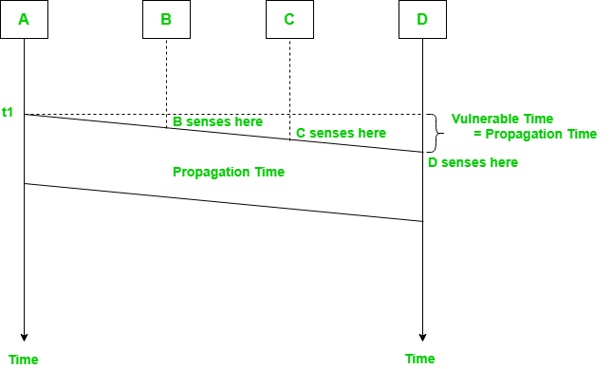
Multiple Access Protocols
Carrier Sense Multiple Access (CSMA)
In the CSMA technique, an attempt is made to avoid collisions by listening to the carrier due to transmission from another user before transmitting, and inhibiting transmission if the channel is sensed busy. This is advantageous when the propagation delay between any source-destination pair is small compared to the packet transmission time. Many CSMA protocols exist; they differ according to the action that a terminal takes to transmit a packet after sensing the channel. In all cases, however, when a terminal learns that its transmission has incurred a collision, it reschedules the transmission of the packet according to a randomly distributed delay. At this new point in time, the transmitter senses the channel again and repeats the algorithm dictated by the protocol.
Fig. 3: Multiple Access Protocols

Slide 46
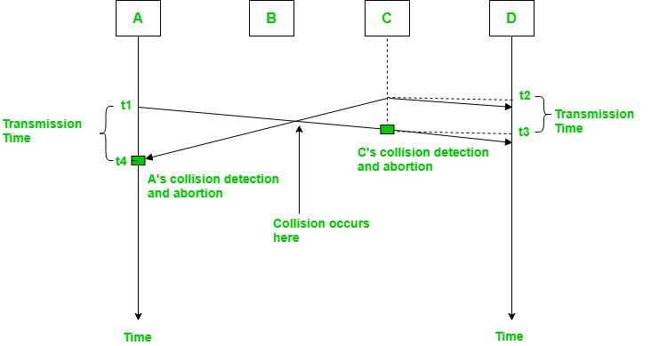
1. Carrier Sense Multiple Access with Collision Detection (CSMA/CD) –
In this method, a station monitors the medium after it sends a frame to see if the transmission was successful. If successful, the station is finished, if not, the frame is sent again.
Fig. 4: CSMA/CD
In the diagram, A starts send the first bit of its frame at t1 and since C sees the channel idle at t2, starts sending its frame at t2. C detects A’s frame at t3 and aborts transmission. A detects C’s frame at t4 and aborts its transmission. Transmission time for C’s frame is therefore t3-t2 and for A’s frame is t4-t1.
So, the frame transmission time (Tfr) should be at least twice the maximum propagation time (Tp). This can be deduced when the two stations involved in collision are maximum distance apart.

Slide 47
2. Carrier Sense Multiple Access with Collision Avoidance (CSMA/CA)
The basic idea behind CSMA/CA is that the station should be able to receive while transmitting to detect a collision from different stations. In wired networks, if a collision has occurred then the energy of received signal almost doubles and the station can sense the possibility of collision. In case of wireless networks, most of the energy is used for transmission and the energy of received signal increases by only 5-10% if a collision occurs. It can’t be used by the station to sense collision. Therefore CSMA/CA has been specially designed for wireless networks.
These are three types of strategies:
Inter Frame Space (IFS) – When a station finds the channel busy, it waits for a period of time called IFS time. IFS can also be used to define the priority of a station or a frame. Higher the IFS lower is the priority.
Contention Window – It is the amount of time divided into slots. A station which is ready to send frames chooses random number of slots as wait time.
Acknowledgements – The positive acknowledgements and time-out timer can help guarantee a successful transmission of the frame.

Slide 48
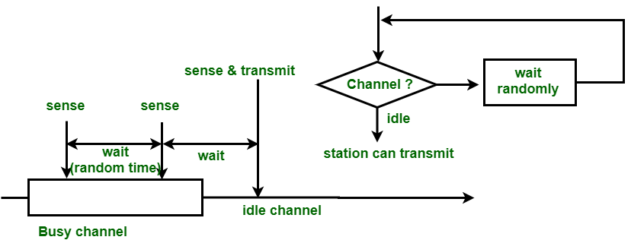
Sharing Medium
CSMA (nonpersistent)
In nonpersistent CSMA, a ready terminal senses the channel and operates as follows. If the channel is sensed idle, the terminal transmits the packet. If the channel is sensed busy, then the terminal schedules the retransmission of the packet to some later time according to the retransmission delay distribution. At this new point in time, it senses the channel and repeats the algorithm described.
Fig. 5: (non-persistent CSMA)

Slide 49
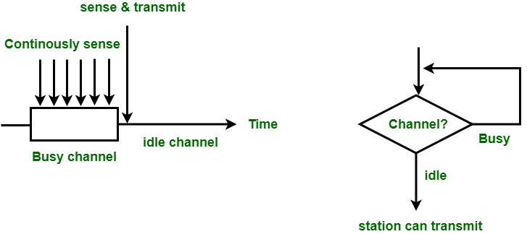
Carrier Sense Multiple Access (CSMA)
CSMA (1-persistent)
In 1-persistent CSMA, station continuously senses channel to check its state i.e., idle or busy so that it can transfer data. In case when channel is busy, station will wait for channel to become idle. When station finds an idle channel, it transmits frame to channel without any delay with probability 1. Due to probability 1, it is called 1-persistent CSMA. The problem with this method is that there is a huge chance of collision, as two or more stations can find channel in idle state and transmit frames at the same time. At the time when a collision occurs the station has to wait for random time for channel to be idle and to start all again.
Fig. 6: (1 – persistent CSMA)

Slide 50
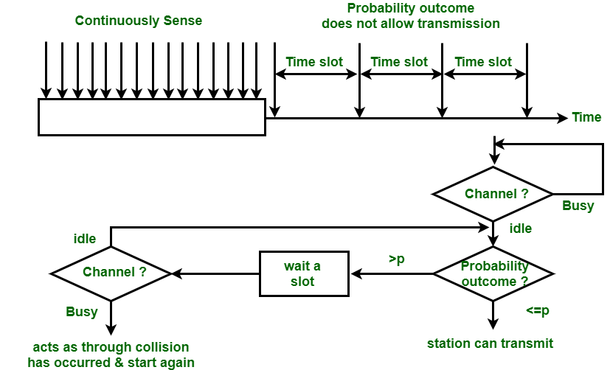
Carrier Sense Multiple Access (CSMA)
CSMA (p-persistent)
The p-persistent scheme involves including an additional parameter p, the probability that a ready packet persists (1 − p being the probability of delaying transmission by τ seconds, where τ is the maximum propagation delay among all pairs). Parameter p is chosen to reduce the level of interference while keeping the idle periods between any two consecutive non-overlapped transmissions as small as possible.
Fig. 7: (p – persistent CSMA)

Slide 51
Concepts of Multiplexing
Multiplexing is the process of combining multiple signals into one signal, over a shared medium. If the analog signals are multiplexed, then it is called as analog multiplexing. Similarly, if the digital signals are multiplexed, then it is called as digital multiplexing.
Multiplexing was first developed in telephony. A number of signals were combined to send through a single cable. The process of multiplexing divides a communication channel into several number of logical channels, allotting each one for a different message signal or a data stream to be transferred. The device that does multiplexing can be called as Multiplexer or MUX.
The reverse process, i.e., extracting the number of channels from one, which is done at the receiver is called as de-multiplexing. The device that does de-multiplexing can be called as de-multiplexer or DEMUX.
The following figures illustrates the concept of MUX and DEMUX. Their primary use is in the field of communications.
Fig. 1: Multiplexing and Demultiplexing
Notes:
TELECOMMUNICATION NETWORKS

Slide 52
The process of multiplexing divides a communication channel into several number of logical channels, allotting each one for a different message signal or a data stream to be transferred. The device that does multiplexing can be simply called as a MUX while the one that reverses the process which is demultiplexing, is called as DEMUX.
Types of Multiplexers
There are mainly two types of multiplexers, namely analog and digital. They are further divided into FDM, WDM, and TDM.
Analog Multiplexing
The analog multiplexing techniques involve signals which are analog in nature. The analog signals are multiplexed according to their frequency (FDM) or wavelength (WDM).
Notes:
TELECOMMUNICATION NETWORKS

Slide 53
Analog Multiplexing
Frequency Division Multiplexing (FDM)
In analog multiplexing, the most used technique is Frequency Division Multiplexing FDM. This technique uses various frequencies to combine streams of data, for sending them on a communication medium, as a single signal.
Example: A traditional television transmitter, which sends a number of channels through a single cable, uses FDM.
Wavelength Division Multiplexing (WDM)
Wavelength Division Multiplexing is an analog technique, in which many data streams of different wavelengths are transmitted in the light spectrum. If the wavelength increases, the frequency of the signal decreases.
Example: Optical fibre Communications use the WDM technique, to merge different wavelengths into a single light for the communication.
Digital Multiplexing
The term digital represents the discrete bits of information. Hence the available data is in the form of frames or packets, which are discrete.
Notes:
NETWORK ACCESS

Slide 54
Digital Multiplexing
Time Division Multiplexing (TDM)
In TDM, the time frame is divided into slots. This technique is used to transmit a signal over a single communication channel, with allotting one slot for each message. Of all the types of TDM, the main ones are Synchronous and Asynchronous TDM.
Synchronous TDM
In Synchronous TDM, the input is connected to a frame. If there are ‘n’ number of connections, then the frame is divided into ‘n’ time slots. One slot is allocated for each input line. In this technique, the sampling rate is common to all signals and hence same clock input is given. The mux allocates the same slot to each device at all times.
Asynchronous TDM
In Asynchronous TDM, the sampling rate is different for each of the signals and the clock signal is also not in common. If the allotted device, for a time-slot, transmits nothing and sits idle, then that slot is allotted to another device, unlike synchronous.
Notes:
NETWORK ACCESS

Slide 55
De-Multiplexer
De-multiplexers are used to connect a single source to multiple destinations. This process is the reverse process of multiplexing. As mentioned previously, it is used mostly at the receivers. DEMUX has many applications. It is used in receivers in the communication systems. It is used in arithmetic and logical unit in computers to supply power and to pass on communication, etc.
De-multiplexers are used as serial to parallel converters. The serial data is given as input to DEMUX at regular interval and a counter is attached to it to control the output of the de-multiplexer.
Both the multiplexers and de-multiplexers play an important role in communication systems, both at the transmitter and the receiver sections.
Statistical Multiplexing
Statistical Multiplexing is a multiplexing technique that allows information from a number of channels to be combined for transmission over communication networks
Statistical multiplexing is sometimes referred to as statistical time-division multiplexing (STDM) or statistical packet multiplexing (SPM), but the shorter term is used more often.
Notes:
NETWORK ACCESS

Slide 56
Statistical Multiplexing cont…
How Statistical Multiplexing Works?
Statistical multiplexing dynamically allocates bandwidth to each channel on an as-needed basis. This is in contrast to time-division multiplexing (TDM) techniques, in which quiet devices use up a portion of the multiplexed data stream, filling it with empty packets. Statistical multiplexing allocates bandwidth only to channels that are currently transmitting. It packages the data from the active channels into packets and dynamically feeds them into the output channel, usually on a FIFO (first in, first out) basis, but it’s also able to allocate extra bandwidth to specific input channels.
Statistical multiplexing devices usually support other features, such as the following:
Store-and-forward error detection and correction capability
Identifies which channel sent each packet of data and corrects errors that occur
Data compression:
Increases the amount of data that can be sent per packet
Notes:
NETWORK ACCESS

Slide 57
Statistical Multiplexing cont…
A multiplexer that is capable of statistically multiplexing several data streams together is sometimes called a statmux. If you have a statmux at each end of a digital line, the receiving statmux can identify the channel of each packet sent by the sending statmux and demultiplex the data stream into its original data channels.
Fig. 2: Statistical Multiplexing
Notes:
NETWORK ACCESS

Slide 58
Virtual Circuits and Datagram Networks
Computer networks that provide connection-oriented service are called Virtual Circuits while those providing connection-less services are called as Datagram networks. For prior knowledge, the Internet which we use is actually based on Datagram network (connection-less) at the network level as all packets from a source to a destination do not follow the same path.
Virtual Circuits
It is connection-oriented, meaning that there is a reservation of resources like buffers, CPU, bandwidth, etc. for the time in which the newly setup virtual circuit is going to be used by a data transfer session.
The first sent packet reserves resources at each server along the path. Subsequent packets will follow the same path as the first sent packet for the connection time.
Since all the packets are going to follow the same path, a global header is required. Only the first packet of the connection requires a global header, the remaining packets generally don’t require global headers.
Since all packets follow a specific path, packets are received in-order at the destination.
Virtual Circuit Switching ensures that all packets successfully reach the Destination. No packet will be discarded due to unavailability of resources.
From the above points, it can be concluded that Virtual Circuits are a highly reliable method of data transfer.

Slide 59
Virtual Circuits cont…
The issue with virtual circuits is that each time a new connection is set up, resources and extra information have to be reserved at every router along the path, which becomes problematic if many clients are trying to reserve a routers resources simultaneously.
It is used by the ATM (Asynchronous Transfer Mode) Network, specifically for Telephone calls.
Datagram Networks
It is a connection-less service. There is no need for reservation of resources as there is no dedicated path for a connection session.
All packets are free to use any available path. As a result intermediate routers calculate routes on the go due to dynamically changing routing tables on routers.
Since every packet is free to choose any path, all packets must be associated with a header with proper information about the source and the upper layer data.
The connection-less property makes data packets reach the destination in any order, which means that they can potentially be received out of order at the receivers end.
Datagram networks are not as reliable as Virtual Circuits.
The major drawback of Datagram Packet switching is that a packet can only be forwarded if resources such as the buffer, CPU and bandwidth are available. Otherwise, the packet will be discarded.
But it is always easy and cost-efficient to implement datagram networks as there is no extra headache of reserving resources and making a dedicated each time an application has to communicate.
Its is generally used by the IP network, which is used for Data services like Internet.

Slide 60
Multiple Access Protocols
Carrier Sense Multiple Access (CSMA)
In the CSMA technique, an attempt is made to avoid collisions by listening to the carrier due to transmission from another user before transmitting, and inhibiting transmission if the channel is sensed busy. This is advantageous when the propagation delay between any source-destination pair is small compared to the packet transmission time. Many CSMA protocols exist; they differ according to the action that a terminal takes to transmit a packet after sensing the channel. In all cases, however, when a terminal learns that its transmission has incurred a collision, it reschedules the transmission of the packet according to a randomly distributed delay. At this new point in time, the transmitter senses the channel again and repeats the algorithm dictated by the protocol.
Fig. 3: Multiple Access Protocols

Slide 61
1. Carrier Sense Multiple Access with Collision Detection (CSMA/CD) –
In this method, a station monitors the medium after it sends a frame to see if the transmission was successful. If successful, the station is finished, if not, the frame is sent again.
Fig. 4: CSMA/CD
In the diagram, A starts send the first bit of its frame at t1 and since C sees the channel idle at t2, starts sending its frame at t2. C detects A’s frame at t3 and aborts transmission. A detects C’s frame at t4 and aborts its transmission. Transmission time for C’s frame is therefore t3-t2 and for A’s frame is t4-t1.
So, the frame transmission time (Tfr) should be at least twice the maximum propagation time (Tp). This can be deduced when the two stations involved in collision are maximum distance apart.

Slide 62
2. Carrier Sense Multiple Access with Collision Avoidance (CSMA/CA)
The basic idea behind CSMA/CA is that the station should be able to receive while transmitting to detect a collision from different stations. In wired networks, if a collision has occurred then the energy of received signal almost doubles and the station can sense the possibility of collision. In case of wireless networks, most of the energy is used for transmission and the energy of received signal increases by only 5-10% if a collision occurs. It can’t be used by the station to sense collision. Therefore CSMA/CA has been specially designed for wireless networks.
These are three types of strategies:
Inter Frame Space (IFS) – When a station finds the channel busy, it waits for a period of time called IFS time. IFS can also be used to define the priority of a station or a frame. Higher the IFS lower is the priority.
Contention Window – It is the amount of time divided into slots. A station which is ready to send frames chooses random number of slots as wait time.
Acknowledgements – The positive acknowledgements and time-out timer can help guarantee a successful transmission of the frame.

Slide 63
Sharing Medium
CSMA (nonpersistent)
In nonpersistent CSMA, a ready terminal senses the channel and operates as follows. If the channel is sensed idle, the terminal transmits the packet. If the channel is sensed busy, then the terminal schedules the retransmission of the packet to some later time according to the retransmission delay distribution. At this new point in time, it senses the channel and repeats the algorithm described.
Fig. 5: (non-persistent CSMA)

Slide 64
Carrier Sense Multiple Access (CSMA)
CSMA (1-persistent)
In 1-persistent CSMA, station continuously senses channel to check its state i.e., idle or busy so that it can transfer data. In case when channel is busy, station will wait for channel to become idle. When station finds an idle channel, it transmits frame to channel without any delay with probability 1. Due to probability 1, it is called 1-persistent CSMA. The problem with this method is that there is a huge chance of collision, as two or more stations can find channel in idle state and transmit frames at the same time. At the time when a collision occurs the station has to wait for random time for channel to be idle and to start all again.
Fig. 6: (1 – persistent CSMA)

Slide 65
Carrier Sense Multiple Access (CSMA)
CSMA (p-persistent)
The p-persistent scheme involves including an additional parameter p, the probability that a ready packet persists (1 − p being the probability of delaying transmission by τ seconds, where τ is the maximum propagation delay among all pairs). Parameter p is chosen to reduce the level of interference while keeping the idle periods between any two consecutive non-overlapped transmissions as small as possible.
Fig. 7: (p – persistent CSMA)

Slide 66
Thank You
For Listening

